Slide 1
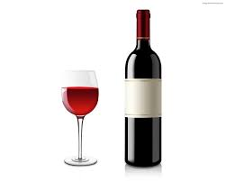
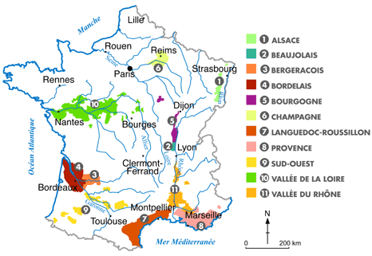
Inside a wine tasting session
Lucas Pinel

Slide 2
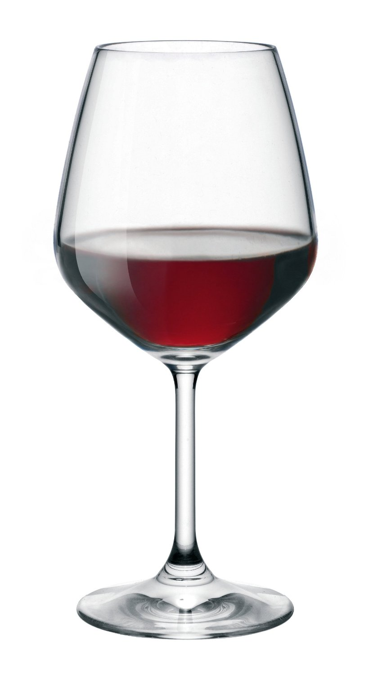
4 KEY STEPS
1. Look
2. Smell
3. Taste
4. Food matching

Slide 3
1. Look
Colour
Transparency
Density
Age
Grape type
“Raising” method
Origin?

Slide 4
4. Food matching
General “rules”
BUT
Personal taste
Improvisation

